Slide 1
Course Details
Course Code : CSE 3075
Course Name: Mobile Application Development [MAD] Credit Structure: 3 Credits (L=1, P=4, C=3)
Instructor In-Charge & Instructor: Ms. B Prema Sindhuri & Dr. Blessed Prince

Slide 2
MODULE 4
Notifications and Data Persistence – Application Level (15 hrs)
Lecture Hours: 5 and Practical Hours: 10
Topics Covered:
Notification,
Shared Preferences,
SQLite database,
Third party library integration (cloud).
Course Outcome Achievable:
C.O. 4: Apply data persistence techniques, to perform CRUD operations.

Slide 3
Notification
A notification is a message that Android displays outside your app's UI to provide the user with reminders, communication from other people, or other timely information from your app. Users can tap the notification to open your app or take an action directly from the notification.
Appearances on a device
Notifications appear to users in different locations and formats, such as an icon in the status bar, a more detailed entry in the notification drawer, as a badge on the app's icon, and on paired wearables automatically.
Status bar and notification drawer
When you issue a notification, it first appears as an icon in the status bar.
Users can swipe down on the status bar to open the notification drawer, where they can view more details and take actions with the notification.

Slide 4
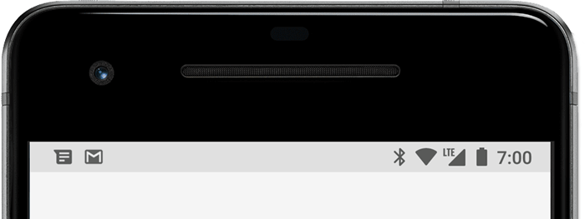
Figure 1. Notification icons appear on the left side of the status bar

Slide 5
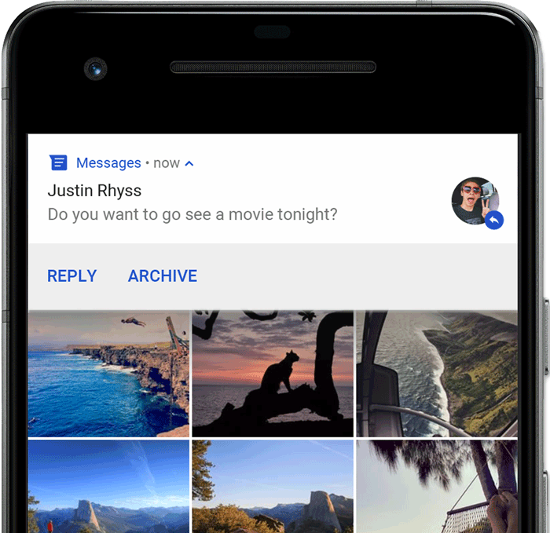
Heads-up notification
Beginning with Android 5.0, notifications can briefly appear in a floating window called a heads-up notification. This behavior is normally for important notifications that the user should know about immediately, and it appears only if the device is unlocked.

Slide 6
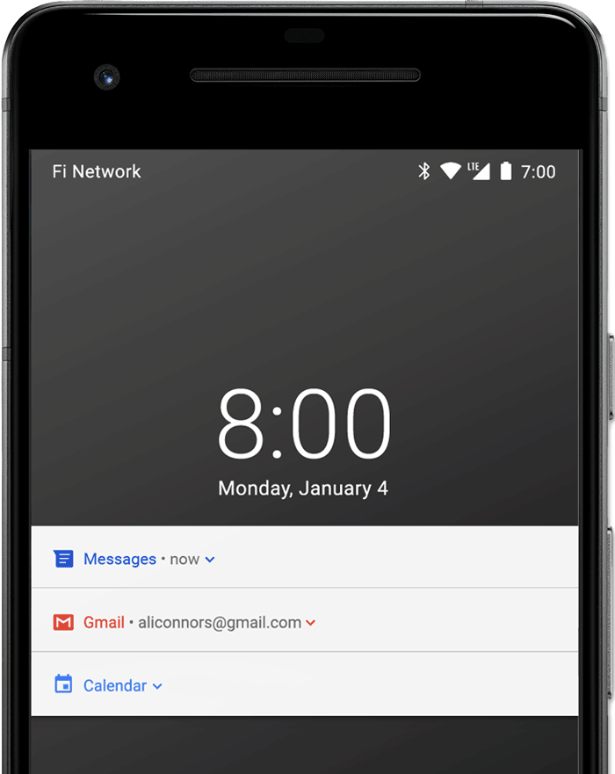
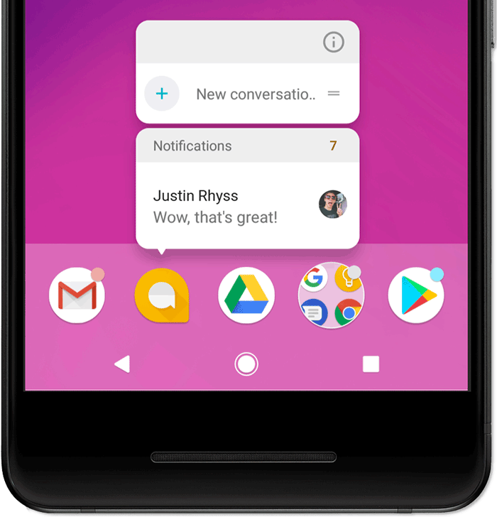
Lock screen
Beginning with Android 5.0, notifications can appear on the lock screen.
You can programmatically set the level of detail visible in notifications posted by your app on a secure lock screen, or even whether the notification will show on the lock screen at all.
App icon badge
In supported launchers on devices running Android 8.0 (API level 26) and higher, app icons indicate new notifications with a colored "badge" (also known as a "notification dot") on the corresponding app launcher icon.
Users can long-press on an app icon to see the notifications for that app. Users can then dismiss or act on notifications from that menu, similar to the notification drawer.

Slide 7
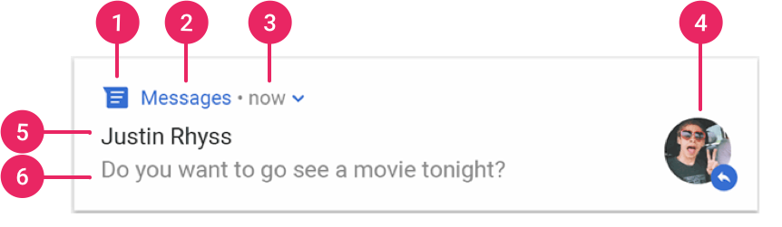
Notification anatomy
The design of a notification is determined by system templates—your app simply defines the contents for each portion of the template. Some details of the notification appear only in the expanded view.

Slide 8
The most common parts of a notification are indicated in figure 7 as follows:
Small icon: This is required and set with setSmallIcon().
App name: This is provided by the system.
Time stamp: This is provided by the system but you can override with setWhen() or hide it with setShowWhen(false).
Large icon: This is optional (usually used only for contact photos; do not use it for your app icon) and set with setLargeIcon().
Title: This is optional and set with setContentTitle().
Text: This is optional and set with setContentText().

Slide 9
Shared Preferences
SharedPreferences object points to a file containing key-value pairs and provides simple methods to read and write them. Each SharedPreferences file is managed by the framework and can be private or shared.
Get a handle to shared preferences
You can create a new shared preference file or access an existing one by calling one of these methods:
getSharedPreferences(): Use this if you need multiple shared preference files identified by name, which you specify with the first parameter. You can call this from any Context in your app.
getPreferences(): Use this from an Activity if you need to use only one shared preference file for the activity. Because this retrieves a default shared preference file that belongs to the activity, you don't need to supply a name.

Slide 10
Write to shared preferences
To write to a shared preferences file, create a SharedPreferences.Editor by calling edit() on your SharedPreferences.
Pass the keys and values you want to write with methods such as: putInt() andputString(). Then call apply() or commit() to save the changes.
Read from shared preferences
To retrieve values from a shared preferences file, call methods such as getInt() and getString(), providing the key for the value you want, and optionally a default value to return if the key isn't present.

Slide 11
Save data using SQLite
Saving data to a database is ideal for repeating or structured data, such as contact information.
The APIs you'll need to use a database on Android are available in the android.database.sqlite package.
Although these APIs are powerful, they are fairly low-level and require a great deal of time and effort to use:
There is no compile-time verification of raw SQL queries. As your data graph changes, you need to update the affected SQL queries manually. This process can be time consuming and error prone.
You need to use lots of boilerplate code to convert between SQL queries and data objects.

Slide 12
Create a database using an SQL helper
Once you have defined how your database looks, you should implement methods that create and maintain the database and tables. Here are some typical statements that create and delete a table:
private static final String SQL_CREATE_ENTRIES = "CREATE TABLE " + FeedEntry.TABLE_NAME + " (" + FeedEntry._ID + " INTEGER PRIMARY KEY," + FeedEntry.COLUMN_NAME_TITLE + " TEXT," + FeedEntry.COLUMN_NAME_SUBTITLE + " TEXT)"; private static final String SQL_DELETE_ENTRIES = "DROP TABLE IF EXISTS " + FeedEntry.TABLE_NAME;

Slide 13
Just like files that you save on the device's internal storage, Android stores your database in your app's private folder. Your data is secure, because by default this area is not accessible to other apps or the user.
The SQLiteOpenHelper class contains a useful set of APIs for managing your database. When you use this class to obtain references to your database, the system performs the potentially long-running operations of creating and updating the database only when needed and not during app startup. All you need to do is call getWritableDatabase() or getReadableDatabase().
To use SQLiteOpenHelper, create a subclass that overrides the onCreate() and onUpgrade() callback methods. You may also want to implement the onDowngrade() or onOpen() methods, but they are not required.

Slide 14
Here's an implementation of SQLiteOpenHelper that uses some of the commands shown above:
public class FeedReaderDbHelper extends SQLiteOpenHelper { // If you change the database schema, you must increment the database version. public static final int DATABASE_VERSION = 1; public static final String DATABASE_NAME = "FeedReader.db"; public FeedReaderDbHelper(Context context) { super(context, DATABASE_NAME, null, DATABASE_VERSION); } public void onCreate(SQLiteDatabase db) { db.execSQL(SQL_CREATE_ENTRIES); }

Slide 15
public void onUpgrade(SQLiteDatabase db, int oldVersion, int newVersion) { db.execSQL(SQL_DELETE_ENTRIES); onCreate(db); } public void onDowngrade(SQLiteDatabase db, int oldVersion, int newVersion) { onUpgrade(db, oldVersion, newVersion); } }
To access your database, instantiate your subclass of SQLiteOpenHelper:
FeedReaderDbHelper dbHelper = new FeedReaderDbHelper(getContext());

Slide 16
Put information into a database
Insert data into the database by passing a ContentValues object to the insert() method:
// Gets the data repository in write mode SQLiteDatabase db = dbHelper.getWritableDatabase(); // Create a new map of values, where column names are the keys ContentValues values = new ContentValues(); values.put(FeedEntry.COLUMN_NAME_TITLE, title); values.put(FeedEntry.COLUMN_NAME_SUBTITLE, subtitle); // Insert the new row, returning the primary key value of the new row long newRowId = db.insert(FeedEntry.TABLE_NAME, null, values);

Slide 17
The first argument for insert() is simply the table name.
The second argument tells the framework what to do in the event that the ContentValues is empty (i.e., you did not put any values). If you specify the name of a column, the framework inserts a row and sets the value of that column to null. If you specify null, like in this code sample, the framework does not insert a row when there are no values.
The insert() methods returns the ID for the newly created row, or it will return -1 if there was an error inserting the data. This can happen if you have a conflict with pre-existing data in the database.

Slide 18
Read information from a database
To read from a database, use the query() method, passing it your selection criteria and desired columns. The method combines elements of insert() and update(), except the column list defines the data you want to fetch (the "projection"), rather than the data to insert. The results of the query are returned to you in a Cursor object.

Slide 19
To look at a row in the cursor, use one of the Cursor move methods, which you must always call before you begin reading values.
Since the cursor starts at position -1, calling moveToNext() places the "read position" on the first entry in the results and returns whether or not the cursor is already past the last entry in the result set.
For each row, you can read a column's value by calling one of the Cursor get methods, such as getString() or getLong().
For each of the get methods, you must pass the index position of the column you desire, which you can get by calling getColumnIndex() or getColumnIndexOrThrow().
When finished iterating through results, call close() on the cursor to release its resources.

Slide 20
Delete information from a database
To delete rows from a table, you need to provide selection criteria that identify the rows to the delete() method.
The mechanism works the same as the selection arguments to the query() method.
It divides the selection specification into a selection clause and selection arguments.
The clause defines the columns to look at, and also allows you to combine column tests.

Slide 21
The arguments are values to test against that are bound into the clause.
Because the result isn't handled the same as a regular SQL statement, it is immune to SQL injection.
// Define 'where' part of query. String selection = FeedEntry.COLUMN_NAME_TITLE + " LIKE ?"; // Specify arguments in placeholder order. String[] selectionArgs = { "MyTitle" }; // Issue SQL statement. int deletedRows = db.delete(FeedEntry.TABLE_NAME, selection, selectionArgs);

Slide 22
Update a database
When you need to modify a subset of your database values, use the update() method.
Updating the table combines the ContentValues syntax of insert() with the WHERE syntax of delete().
SQLiteDatabase db = dbHelper.getWritableDatabase(); // New value for one column String title = "MyNewTitle"; ContentValues values = new ContentValues(); values.put(FeedEntry.COLUMN_NAME_TITLE, title);

Slide 23
END OF MODULE 4

Slide 24
Learn more …
https://developer.android.com/develop/ui/views/notifications
https://developer.android.com/training/data-storage/shared-preferences
https://www.geeksforgeeks.org/shared-preferences-in-android-with-examples/
https://developer.android.com/reference/android/database/sqlite/SQLiteDatabase
https://www.geeksforgeeks.org/how-to-create-and-add-data-to-sqlite-database-in-android/
https://developer.android.com/studio/projects/android-library
https://www.geeksforgeeks.org/how-to-add-external-library-in-android-studio/

Slide 25
Thank You
25
Notes:
25

